Slide 1




Data
Culture
society
@edCDCS
Notes:
MT

Slide 2


Text
extraction
basics
10/11/2023
@edCDCS
Notes:
MT

Slide 3


Overview
Day 1
Introduction to text extraction: history, techniques, problems
Applying text extraction methods in research
Hands-on activities
www.cdcs.ed.ac.uk

Slide 4
Discussion
Are you familiar with text extraction or OCR? What do you know already, and what do you hope to learn?
Summarize your experience with digital research methods. What tools have you used/do you plan to use in your work, and why?
www.cdcs.ed.ac.uk

Slide 5
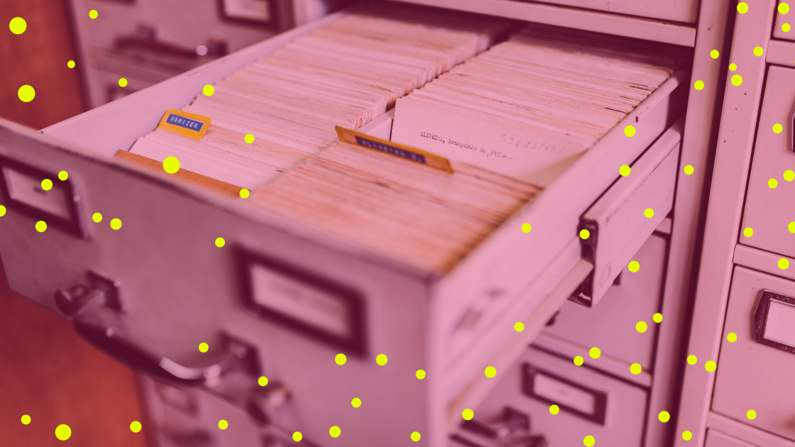
What Is OCR?
Optical Character Recognition
Transforms written, typed, or printed text into encoded text
Creates machine-readable documents that can be searched, edited, and analysed computationally
Multi-step process:
Select image or text to be scanned
Scan image with OCR software
Clean and save the OCR-produced document
Improves accessibility: compatible with text-to-speech technology
www.cdcs.ed.ac.uk
Notes:
MT

Slide 6
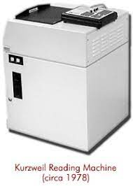
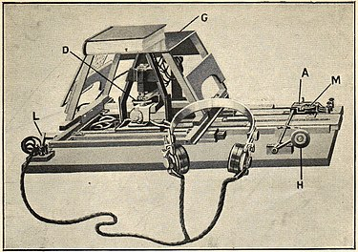
OCR Timeline: A Brief History
Early Foundations
1914: Emanuel Goldberg invents a machine that converts text into telegraph code; Edmund Fournier d’Albe invents the Optophone, which converts text to audio
tones matched with letters
1931: Goldberg invents the “Statistical Machine,” which searches archives through optical code recognition
Mid-Century Machinery
1974: Ray Kurzweil develops the “Reading Machine,” an early form of OCR technology compatible with text-
to-speech software
1976: Kurzweil sells to Xerox
The Internet Era
1990s-00s: OCR goes mainstream; improved accuracy; mass digitization projects
00s-present: increased accessibility and accuracy
www.cdcs.ed.ac.uk
Notes:
MT

Slide 7
Activity & Discussion
Identify a dataset that you might use in your research. (You can find one online or use one you already have.)
Write a workflow of the steps you will take to obtain encoded text from your dataset.
Consider any problems, errors, or other obstacles you might encounter during this process. How might you address them?
Share your dataset, workflow, and plan with your small group.
www.cdcs.ed.ac.uk

Slide 8
Document Preprocessing
Optimise images for better text extraction
Image capture quality
DPI (dots per inch)
File formats (TIFF, JPEG, PNG)
Colour vs. Black and white
Text orientation
www.cdcs.ed.ac.uk

Slide 9

Accuracy is never 100%
Patches can correct errors, but only if they are predictable
Missed column/margin formatting can scramble or cut off text
Age of and damage to scanned material leads to errors
Human error
Newer OCR is faster and more accurate than older software
Problems & Errors
www.cdcs.ed.ac.uk
Notes:
MT

Slide 10
Activity & Discussion
Identify some issues you might encounter when OCRing the following documents.
Are there any steps you could take when preprocessing the text that might change the OCR output?
www.cdcs.ed.ac.uk

Slide 11
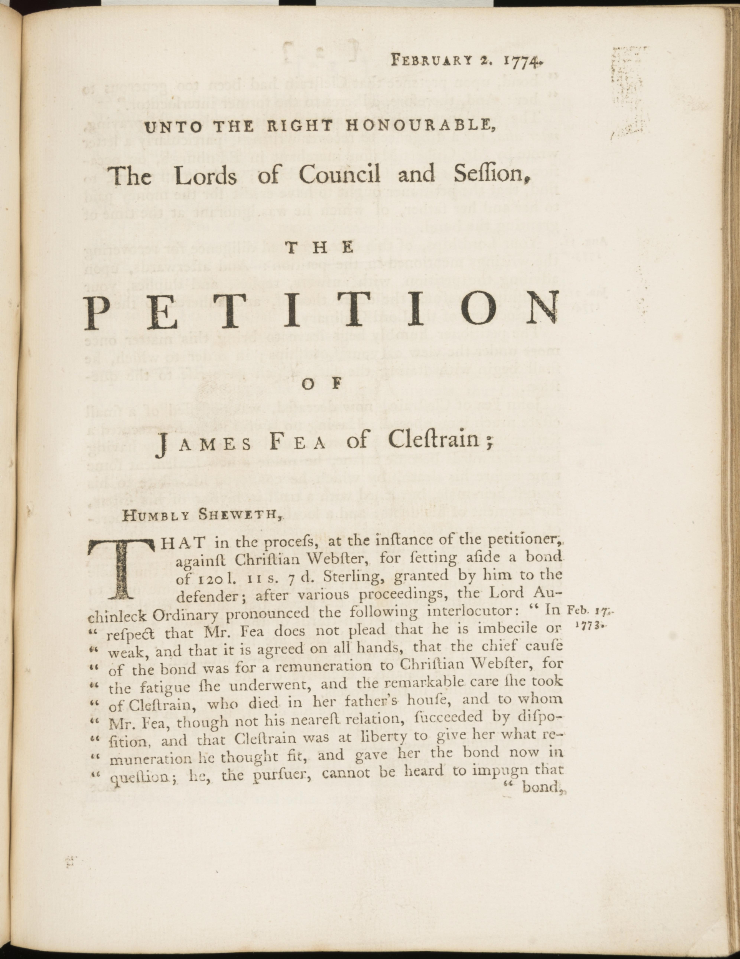
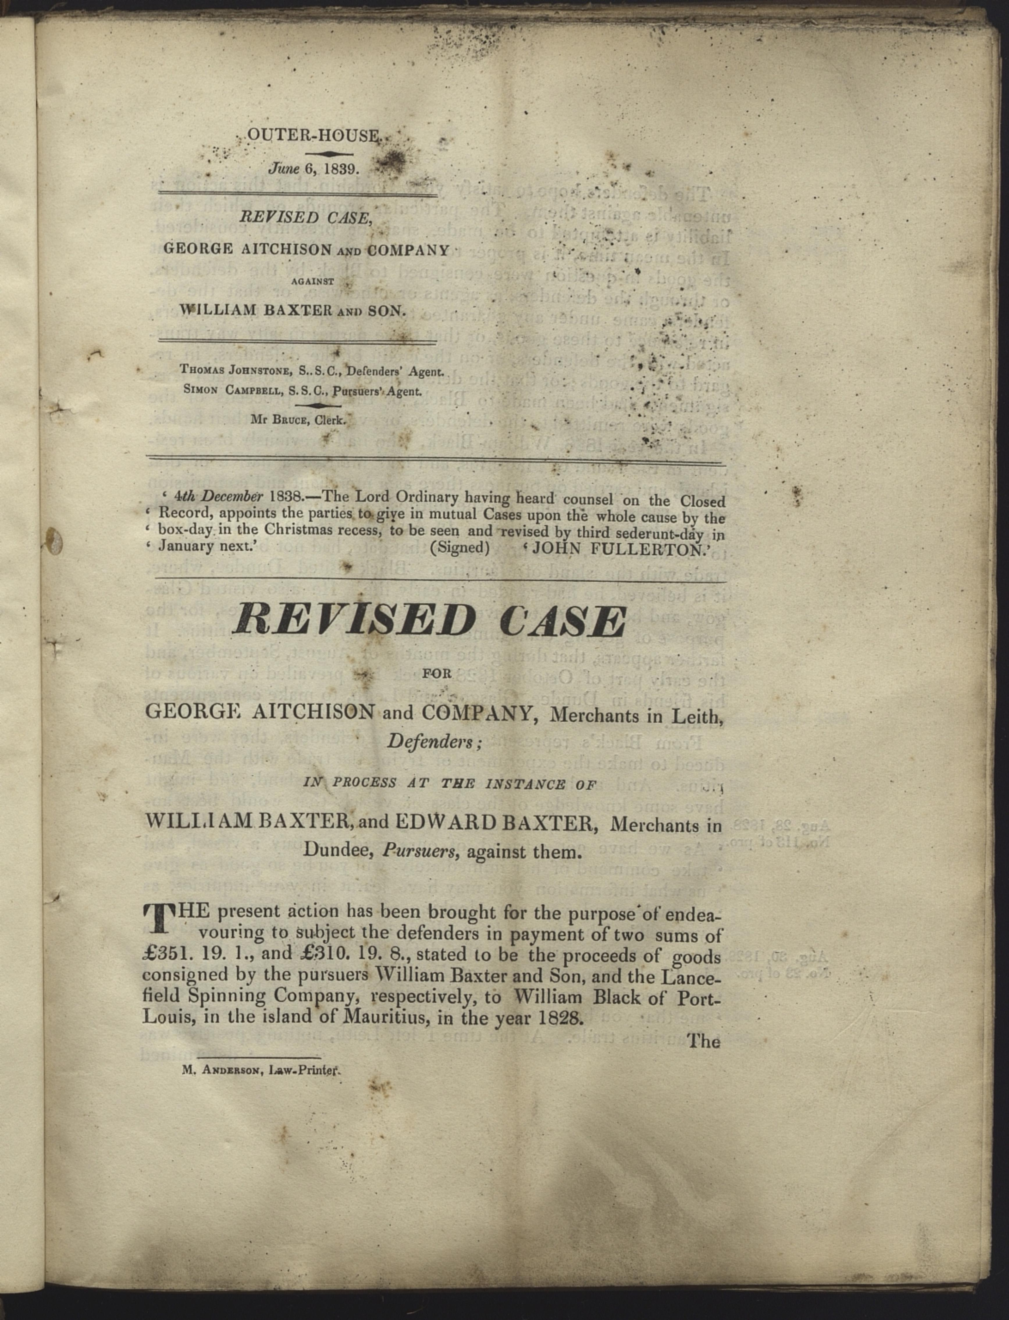
Image 20, EUL0011, University of Edinburgh
Image 1, EUL0281, University of Edinburgh
www.cdcs.ed.ac.uk
Notes:
MT

Slide 12
Manually: Read through the text and manually change what needs to be changed
Regex: Programmatically fix repetitive errors
Patches and Machine Learning techniques: Certain software have embedded word correction capabilities
How to Clean your OCR File
www.cdcs.ed.ac.uk
Notes:
MT

Slide 13
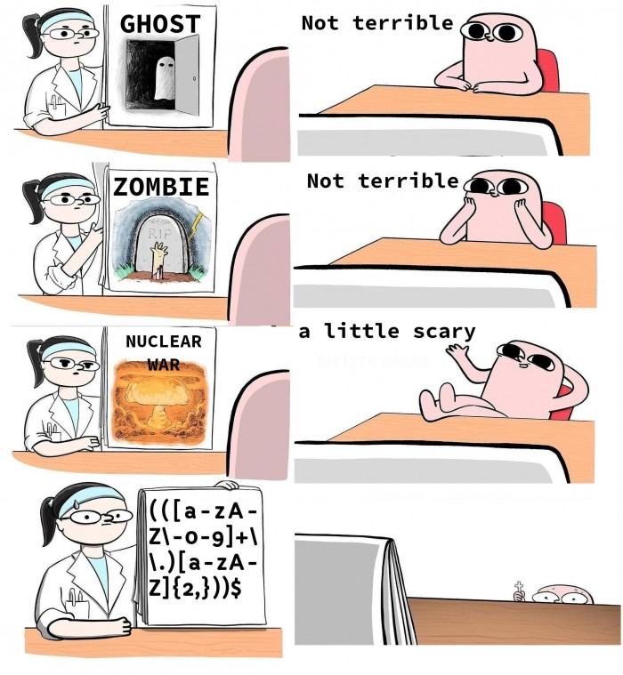
Regex
Concept used in many different programming environments for pattern matching
Powerful tool to find, manage, and transform data and files
Use a sequence of characters to define a search to match strings
Match types of characters (e.g. ‘upper case letters’, ‘digits’, ‘spaces’, etc.)
Match patterns that repeat any number of times
https://devhumor.com/media/the-nightmare
www.cdcs.ed.ac.uk
Notes:
MT

Slide 14
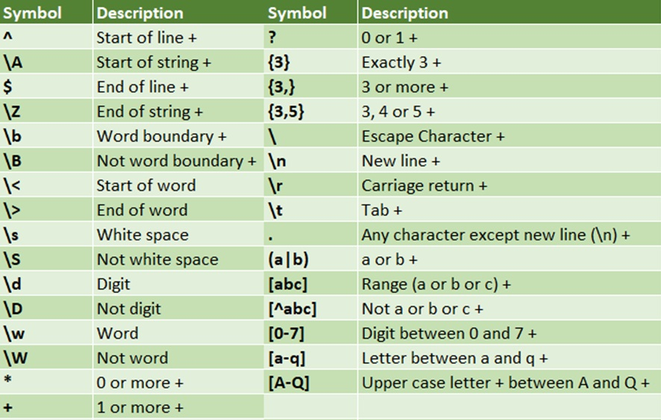
Regex
https://programminghistorian.org/en/lessons/cleaning-ocrd-text-with-regular-expressions
https://programminghistorian.org/en/lessons/understanding-regular-expressions
https://librarycarpentry.org/lc-data-intro/01-regular-expressions.html
www.cdcs.ed.ac.uk
Notes:
MT

Slide 15
Activity & Discussion
Identify a pdf you want to use
Try the following out of the box options
https://tools.pdf24.org/en/ocr-pdf
https://www.onlineocr.net/
https://www.sodapdf.com/ocr-pdf/
https://www.sejda.com/ocr-pdf
https://ocr.space/
https://avepdf.com/pdf-ocr
Compare the results
Which one performed better?
Which are the limitations of these options?
www.cdcs.ed.ac.uk

Slide 16
OCR In the Wild: Real-World Examples
Depositing a check on a mobile banking app
Using the airport’s e-Passport Gates
Translating text with language recognition
Searching a digital database of historical public records
Digitizing physical archives and making them accessible online
Creating a dataset of physical books for text mining research
Adding machine-created metadata to digital collections
www.cdcs.ed.ac.uk
Notes:
MT

Slide 17
Handwritten Text Recognition (HTR) technologies are being developed
They are designed to be used on handwritten text and are often distinguished from OCR
Transkribus is one of the leading options
Try it with an image of text here:
https://readcoop.eu/transkribus/
Alternatives: HTR
www.cdcs.ed.ac.uk
Notes:
MT

Slide 18
Tesseract
Optical character recognition engine for various operating systems
Developed in the '80s; available open-source since 2005
One of the most accurate open-source OCR engines available
Originally just English, but more and more languages have been added
Can run from command line or embedded in main coding languages (R & Python)
www.cdcs.ed.ac.uk
Notes:
MT

Slide 19

Digital Scholar Lab
www.cdcs.ed.ac.uk
Notes:
LO

